Slide 1


Machine Learning with Python
By ​
Arun Panayappan​

Slide 2


Slide 3


Slide 4
Agenda
Phase 1 :
Introduction to Machine Learning
Introduction to Python
Math for ML
Linear Regression
Logistic Regression
Phase 2 :
Classification and Clustering
Time series and Reinforcement learning
Phase 3:
Text mining and Data Visualization
Bayesian and Support vector machines
Advanced classification algorithms

Slide 5
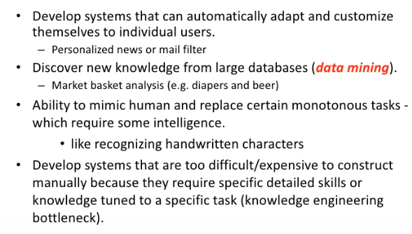
Why Machine Learning

Slide 6
Why Now?
Flood of data available (especially with the advent of the internet)
Increasing computation power
Growing progress in available algorithms and theory developed by researchers
Increasing support from industries

Slide 7


Some Sample Applications
Amazon product recommendations
Siri, Google Now
Text to speech, translations
Image recognition
Chatbots

Slide 8
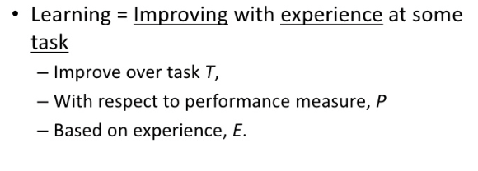
How Does A Machine Learn?

Slide 9
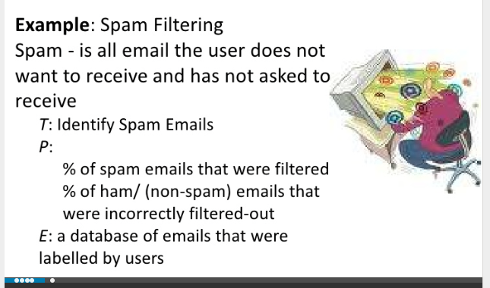
Simple Machine Learning Example

Slide 10
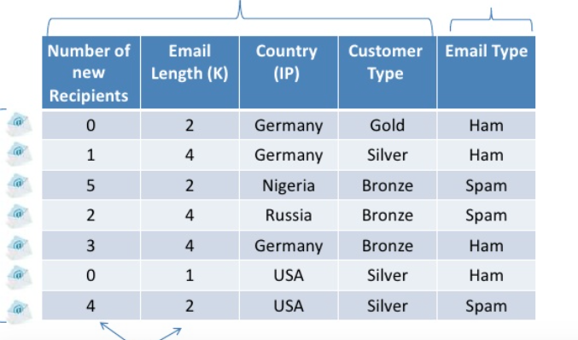
Preprocess Data

Slide 11
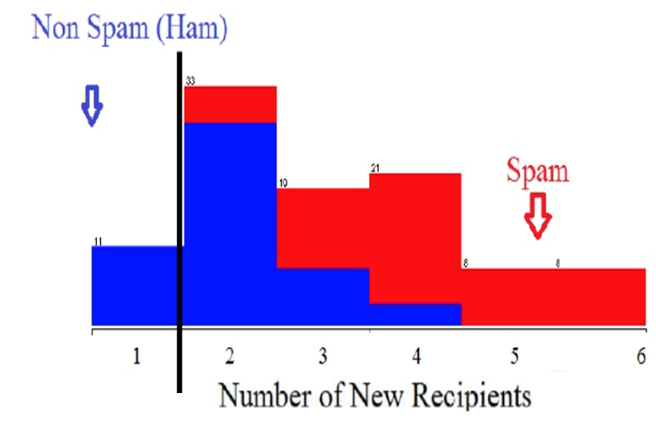
Spam Classifier

Slide 12
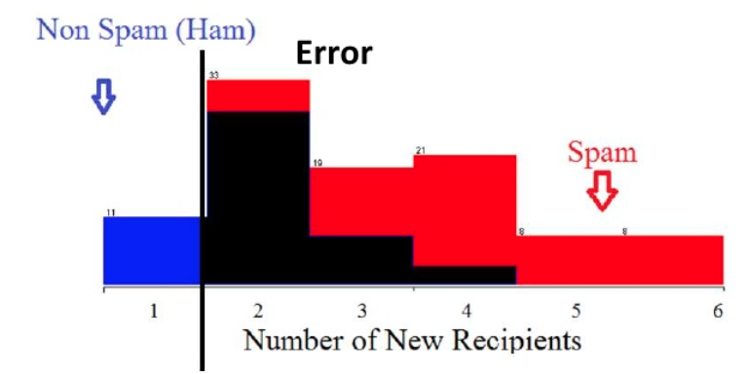
Spam Classifier

Slide 13
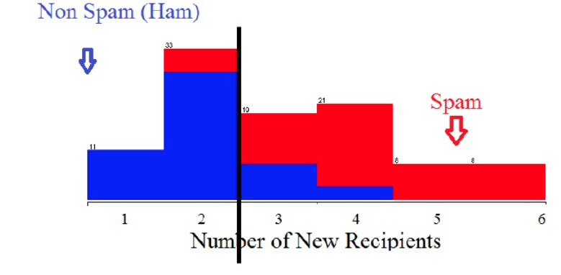
Spam Classifier

Slide 14
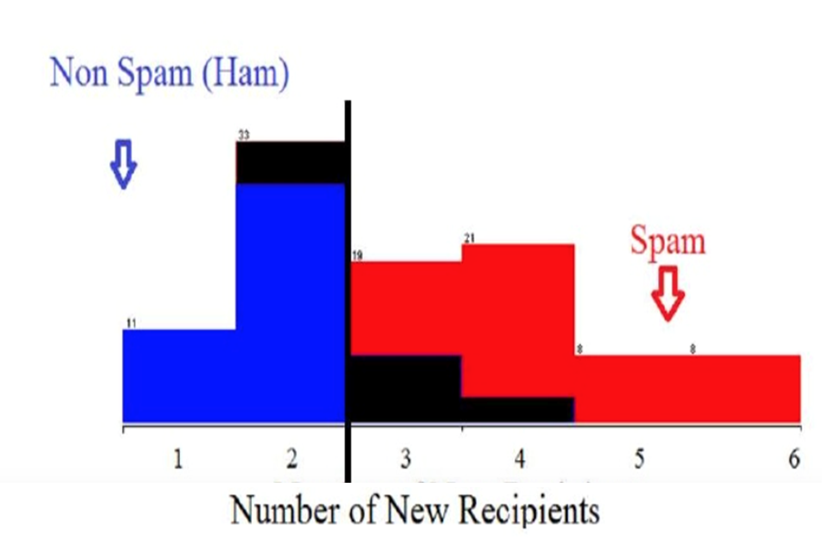
Spam Classifier

Slide 15
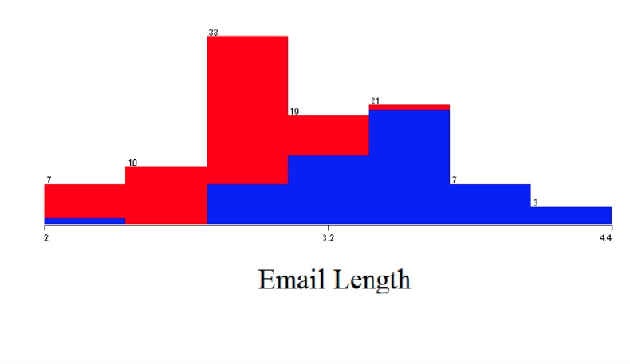
Spam Classifier

Slide 16
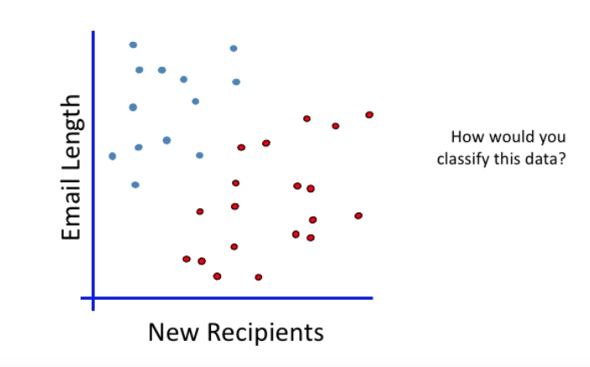
Linear Classifier

Slide 17
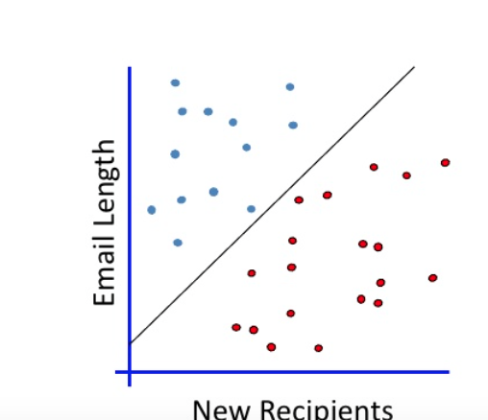
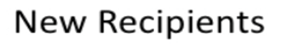
Best Fit Line

Slide 18
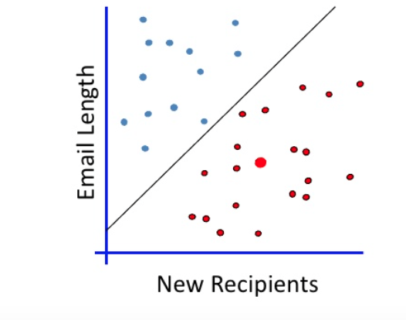
When A New Email Is Sent

Slide 19
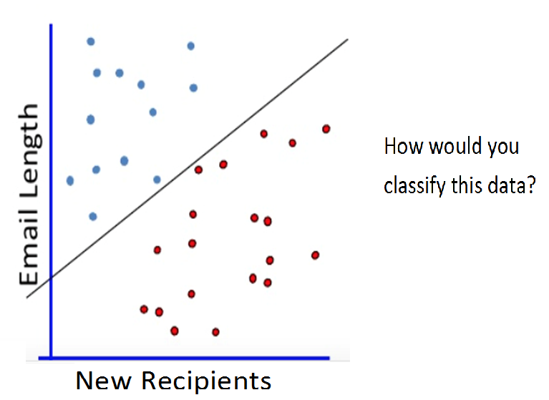
Which Is The Right Line?

Slide 20
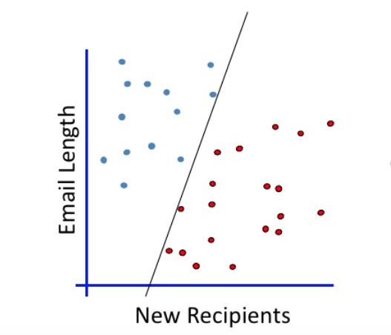
Which Is The Right Line?

Slide 21
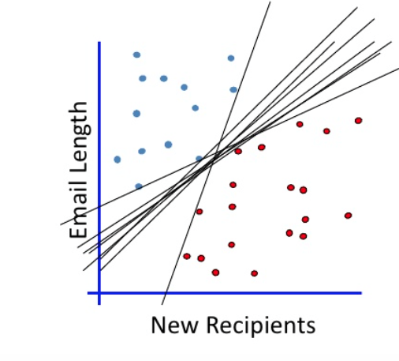
Which Is The Right Line?

Slide 22
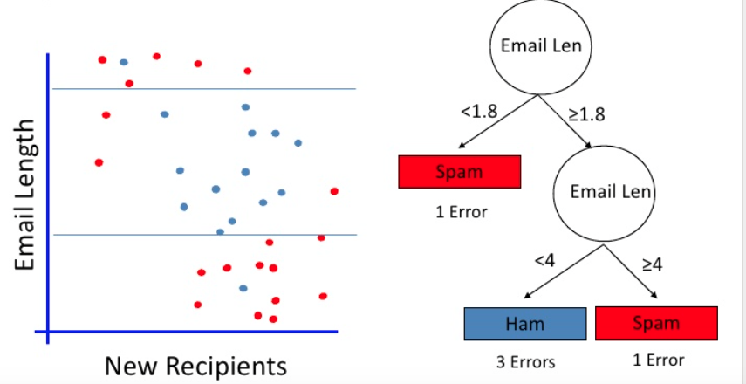
Sample Decision Tree

Slide 23

Classifier

Slide 24
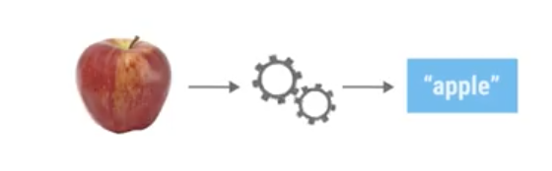
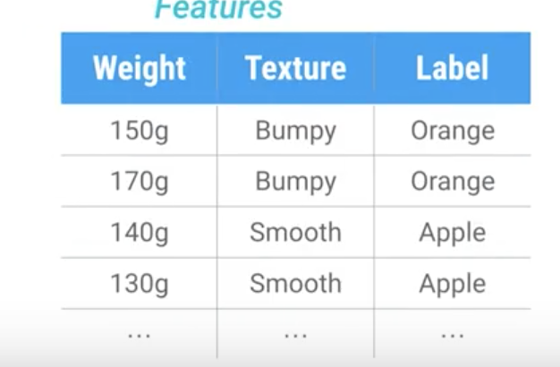
Data Set - Fruits

Slide 25
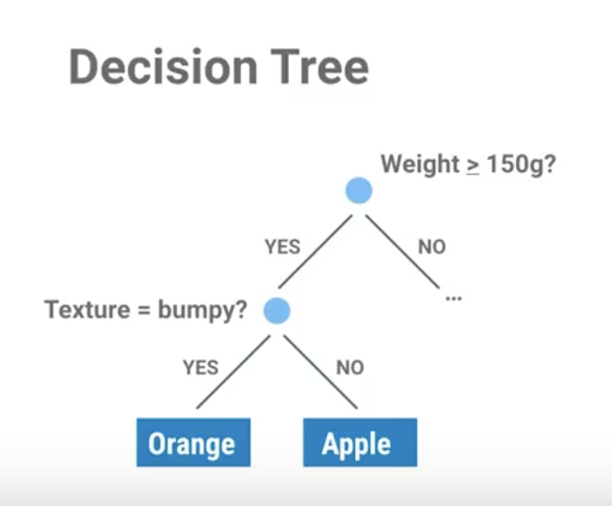
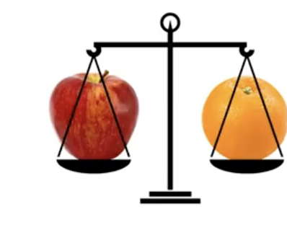
Decision Tree

Slide 26
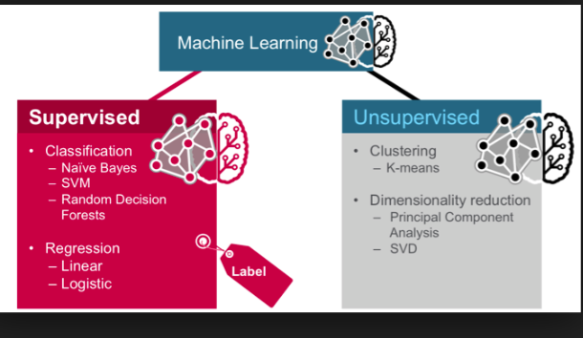
https://github.com/arunpa0206/mltraining

Slide 27
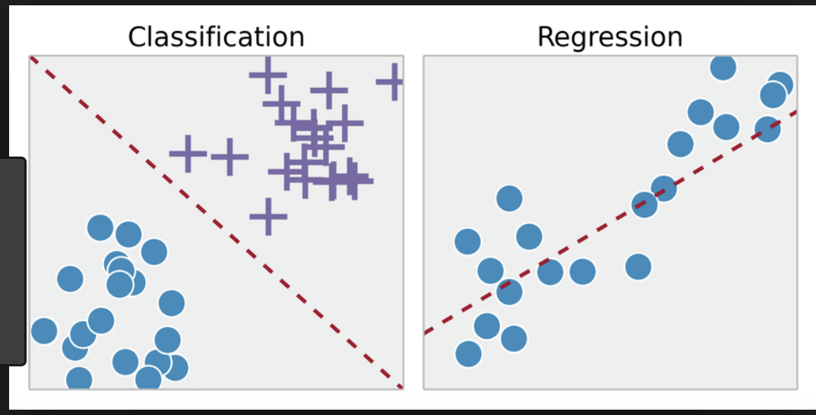
Regression vs Classification

Slide 28
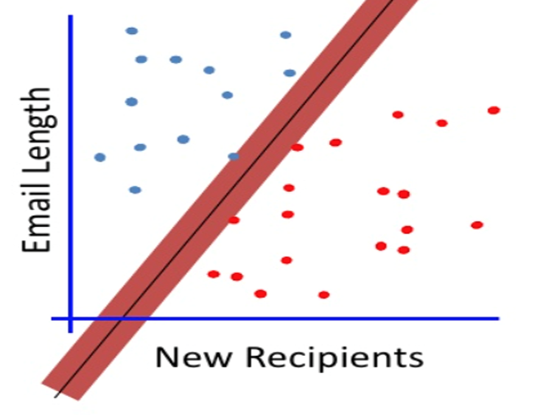
Maximum Margin

Slide 29
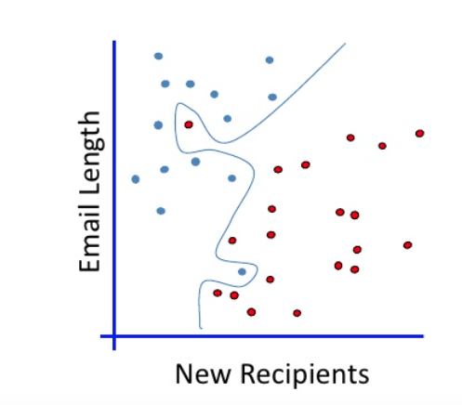
No Linear Classifier Fits This

Slide 30
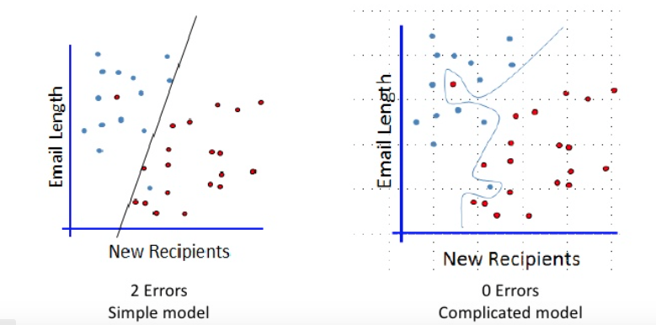
Which One?

Slide 31
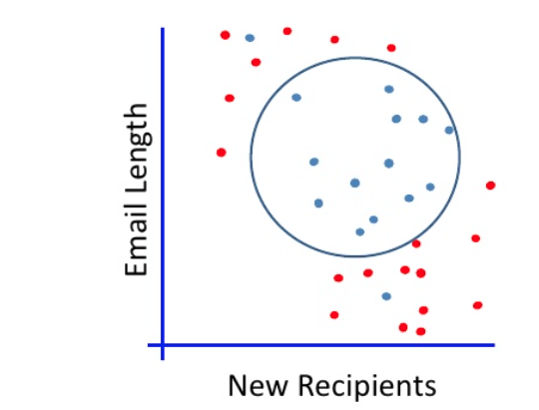
Non-Linear Separation

Slide 32
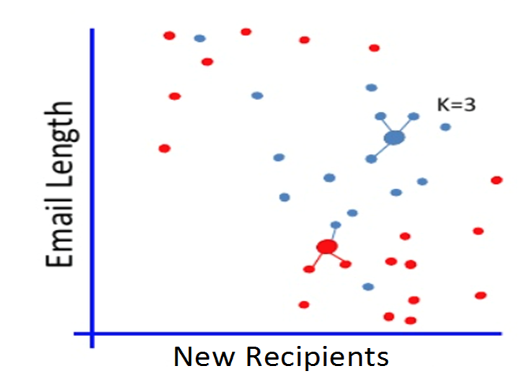
K-Nearest Neighbors

Slide 33
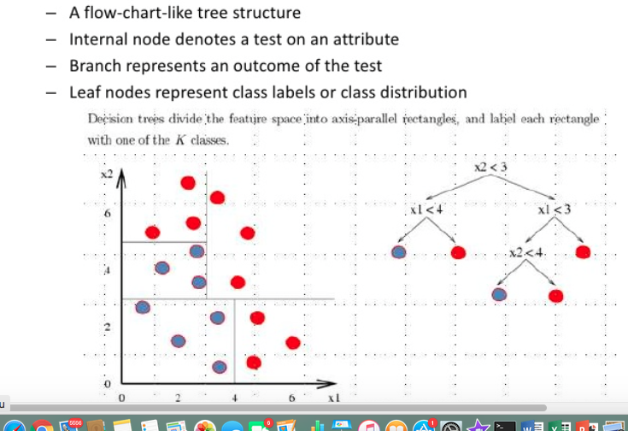
Decision Trees

Slide 34
Sample Decision Tree

Slide 35
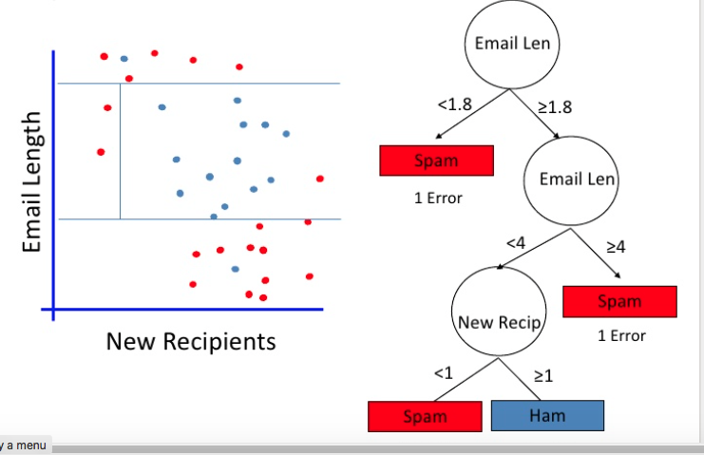
Decision Tree With Multiple Constraints

Slide 36
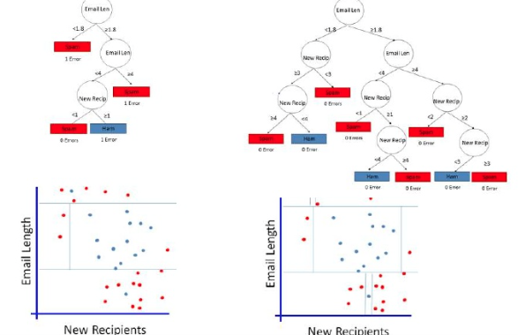
Which One?

Slide 37
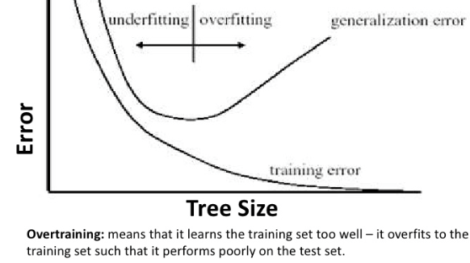
Overfitting And Under Fitting

Slide 38
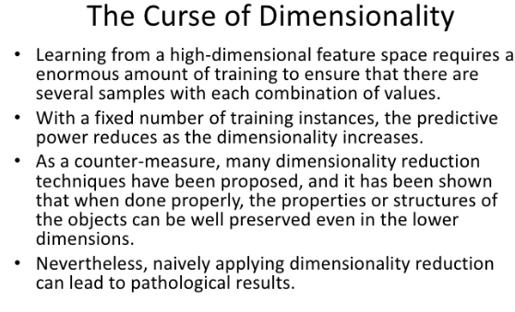
Less is More

Slide 39
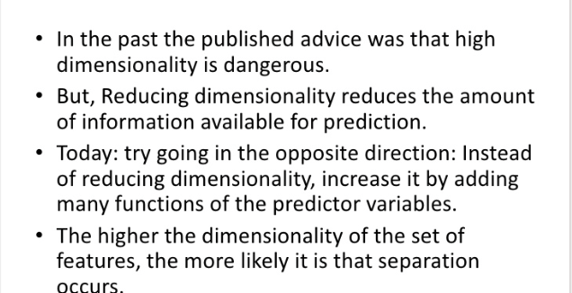
Less Is More – Not Any More

Slide 40
Introduction to Python

Slide 41
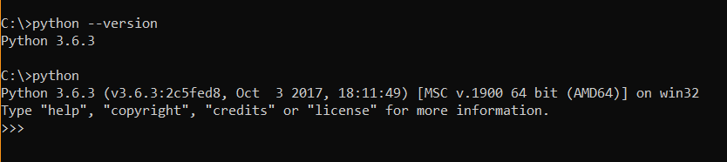
Step 1 - Starting with Python

Slide 42

Step 2 - Hello world Example

Slide 43
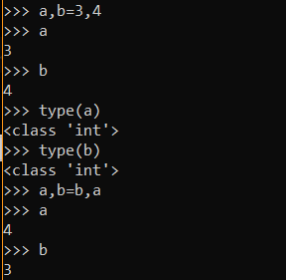
Step 3 – Variables

Slide 44
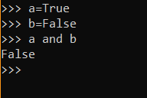
Step 4 – Logical Operator

Slide 45
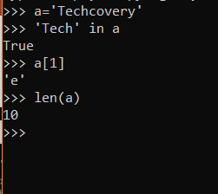
Step 5 - Strings

Slide 46
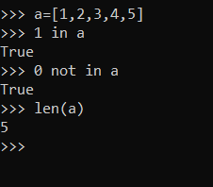
Step 6 - Lists

Slide 47
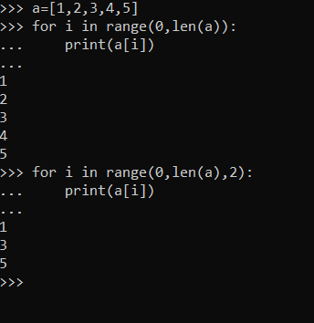
Step 7 – for Statement

Slide 48
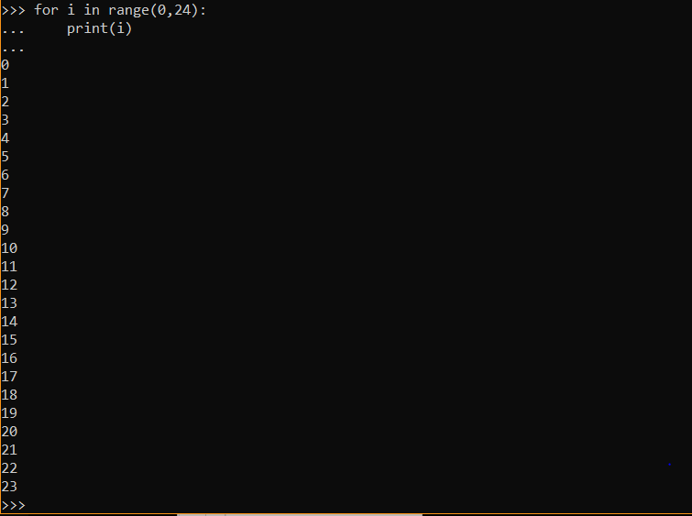
Step 8 – for Statement

Slide 49
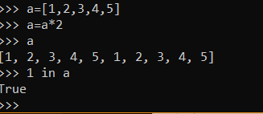
Step 9 – List Operators

Slide 50
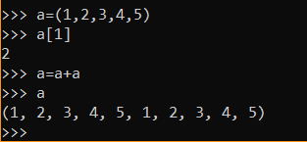
Step 10 - Tuples

Slide 51
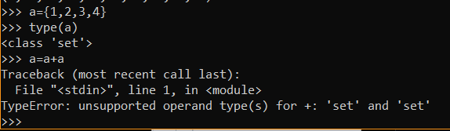
Step 11 - Set

Slide 52
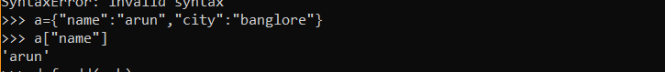
Step 12 - Dictionary

Slide 53
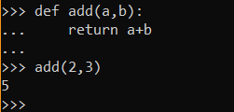
Step 13 - Functions

Slide 54
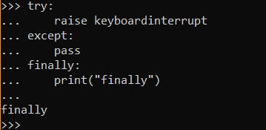
Step 14 - Exception

Slide 55
Python Numpy

Slide 56
Numpy – What is it?
A library to play with multi-dimensional arrays
It is Numerical Python
Numpy and Mathplotlib go hand in glove
This is a open source library

Slide 57
Installing ML Libraries Using Conda
https://www.davidculley.com/installing-python-on-a-mac/
https://conda.io/docs/user-guide/install/windows.html

Slide 58
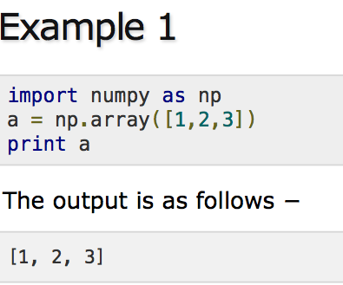
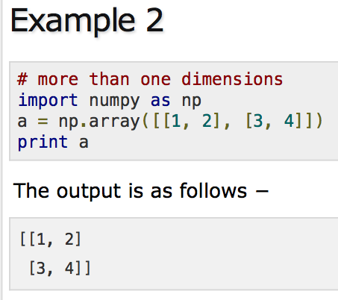
Numpy Examples - one Dimensional Two Dimensional Arrays

Slide 59
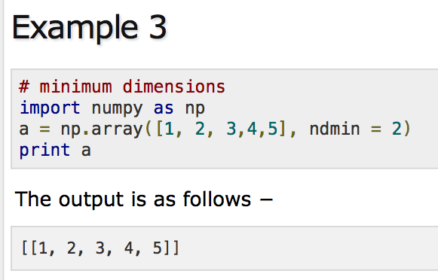
Numpy Examples - Set Dimensions

Slide 60

Numpy Examples - Set Data type

Slide 61


Numpy Arrays - Shape

Slide 62

Numpy Arrays And Examples - Reshape

Slide 63

Numpy Arrays - Range

Slide 64

Numpy Arrays With Multiple Dimensions - 3 Dimensional arrays

Slide 65
For More Examples On Numpy
https://www.tutorialspoint.com/numpy/numpy_array_from_existing_data.htm

Slide 66
Pandas

Slide 67
Pandas Overview
Used for data cleansing and analysis
Open source, low latency data processing
Used for econometrics of multidimensional data (Pandata)
Wes McKinney founded this in 2008

Slide 68

Key Features

Slide 69

Data Structures in Pandas

Slide 70

Series

Slide 71

Frames

Slide 72

Panels

Slide 73


Empty Series - Example

Slide 74

Pandas Indexing

Slide 75


Pandas – Series from dict

Slide 76

Pandas data frame representation

Slide 77

Create an empty data frame

Slide 78

Create data frames from lists

Slide 79

Dataframes with row indices

Slide 80

Selecting columns

Slide 81

Creating panels

Slide 82
Matplotlib overview

Slide 83


Example plot

Slide 84


Plot 2D graphs

Slide 85

Plotting with different styles

Slide 86
More examples
https://matplotlib.org/users/pyplot_tutorial.html

Slide 87
Math for ML

Slide 88

Mathematics for Machine Learning

Slide 89

Linear Algebra - Motivation

Slide 90

Motivation – Linear Algebra

Slide 91

Probability - Motivation

Slide 92

Random Samples

Slide 93

Statistics - Motivation

Slide 94

Measures of Variation

Slide 95


Geometry - Basics

Slide 96

Motivation - Calculus

Slide 97

Meaning of Derivative

Slide 98
Vector Basics

Slide 99

Vector Has Magnitude And Direction

Slide 100

Magnitude Of A Vector

Slide 101

Addition of two vectors

Slide 102

Subtraction of two vectors

Slide 103

Projection of a vector

Slide 104

Cosine and Dot product

Slide 105

Vector Dot Product

Slide 106

Vector – Space – NLP Example

Slide 107

Basis Vectors - Definition

Slide 108

Basis Vectors

Slide 109

Spanning Set of a vector space

Slide 110

Linearly dependent vectors

Slide 111
Matrices

Slide 112

Transformation

Slide 113

Matrix transformation of spaces

Slide 114

Matrix transformation of spaces

Slide 115

Determinant

Slide 116

Determinant of matrices
https://youtu.be/Ip3X9LOh2dk

Slide 117

Rotation Matrix

Slide 118

Composition of Matrix transforms

Slide 119

Rotation and Shear

Slide 120

Gauss Elimination

Slide 121

Inverse Matrix

Slide 122

Sparse Matrix Representation - Triplet method
Matrix contains more number of ZERO values than NON-ZERO values, such matrix is known as sparse matrix
Non-zero values along with their row and column index values
0th row stores total rows, total columns and total non-zero values in the matrix

Slide 123

Sparse Matrix Representation - Linked List
Row: Index of row, where non-zero element is located
Column: Index of column, where non-zero element is located
Value: Value of the non zero element located at index – (row,column)
Next node: Address of the next node

Slide 124
Why to use Sparse Matrix
Storage: There are lesser non-zero elements than zeros and thus lesser memory can be used
Computing time:Computing time can be saved by logically designing a data structure traversing only non-zero elements..

Slide 125
Application of Sparse matrix
Latent Semantic Analysis is a sparse matrix representation of the text
Calculation of the similarity between sparse customer behavior vectors using distance measures such as Euclidean distance or dot products

Slide 126
Special matrices
Identity Matrix
Transpose Matrix
Symmetric and Skew Symmetric
Upper and Lower triangular
Orthogonal
Diagonal

Slide 127
Eigenvalues and Eigenvectors

Slide 128

Eigen Vector

Slide 129

A transformation

Slide 130

Axis of rotation of an object

Slide 131

Eigen Vector Definition

Slide 132

Diagonalization

Slide 133

Diagonal Matrix

Slide 134

Diagonalization

Slide 135
Computing Eigen vectors - Example

Slide 136

Changing to Eigen Basis

Slide 137

Change of basis

Slide 138
Calculus for ML

Slide 139

Fundamental theorem of Calculus

Slide 140
Fundamental theorem of Calculus
https://youtu.be/WUvTyaaNkzM

Slide 141

Multivariate functions
Input is made up of multiple numbers
Associating points in one space with points in another space

Slide 142

Definition of derivative

Slide 143

Power Rule
The Power rule tells us how to differentiate expressions of the form x^n

Slide 144

What is Chain Rule

Slide 145

Chain rule
https://youtu.be/YG15m2VwSjA?t=540

Slide 146

Multivariate Chain Rule

Slide 147

Second Order Derivative
Measures how the rate of change of a quantity is itself changing
Derivative of the derivative of the given function
Describes how the slope changes over the independent variable

Slide 148

Differential Equation
states how a rate of change (a "differential") in one variable is related to other variables

Slide 149

Partial Derivatives
Defined as derivatives of a function of multiple variables when all but the variable of interest are held fixed

Slide 150

Integration
When data is drawn probabilistically from a continuous space, then average values over the data are computed by integrals
Used in Determining the area under the curve

Slide 151

Lagrange Multipliers
Strategy for finding the local maxima and minima of a function
Allows us to maximize or minimize functions with the constraint
It helps to find an optimal point for a constrained optimization problem
Used to develop Support Vector Machine algorithm

Slide 152
Introduction to optimization

Slide 153

Newton Raphson method

Slide 154

Slope

Slide 155

Newton Raphson method

Slide 156

Newton Raphson Formula

Slide 157

Newton Raphson iteration 1

Slide 158

Newton Raphson iteration 2

Slide 159

Newton Raphson iteration 3

Slide 160

Newton Raphson Iteration 4
Used in Optimization algorithm
Objective of this method is to find better training directions

Slide 161

Gradient
The gradient of a function f, denoted as ∇f, is the collection of all its partial derivatives into a vector
Represent the combination of rate of change in x,y,z at a given point in three or higher dimensional curve

Slide 162
Gradient
https://www.youtube.com/watch?v=tIpKfDc295M&list=PLSQl0a2vh4HC5feHa6Rc5c0wbRTx56nF7&index=19

Slide 163

Partial Differentiation - Gradient

Slide 164
Gradient Vector
Gradient vector points the direction of greatest rate of increase of f(x,y)
The matrix of partial derivatives of a scalar-valued function
Used to determine how directional derivatives at a point change as the direction changes,
https://www.youtube.com/watch?v=_-02ze7tf08&list=PLSQl0a2vh4HC5feHa6Rc5c0wbRTx56nF7&index=20

Slide 165

Directional Derivative
Rate at which the function changes at a point in the given direction
Directional derivative is taken along some vector in the input space
The directional derivative of f
along v,is the resulting rate of change in the output of the function

Slide 166

Gradient Descent

Slide 167

Steps for GradientDescent

Slide 168
Steepest Gradient Descent
An algorithm for finding the nearest local minimum of a function
Special case of gradient descent where the step length is chosen to minimize the objective function value
https://www.youtube.com/watch?v=TEB2z7ZlRAw&t=7s

Slide 169
Probability

Slide 170

Probability – Random Experiment

Slide 171

Sample space

Slide 172

Types of events

Slide 173

Independent Events

Slide 174
Probability Estimators
Sample statistics : A random variable whose value depends on which population item is included in sample
Sampling Variation : variation for sample statistics
Estimators : Statistics derived from sample too infer a population parameters
Estimate : value of estimators in particular sample

Slide 175

Conditional Probability

Slide 176

Bayes Theorem

Slide 177

Random Variable
Numerical description of the outcome of a statistical experiment
Random variable that may assume only a finite number values is said to be discrete
One that may assume any value in some interval on the real number line is said to be continuous

Slide 178


Probability Distribution Of Random variable
For discrete random variable, x, the probability distribution is defined by a probability mass function
For continuous random variable, x, the probability distribution is defined by a probability density function
The probability density function provides the height or value of the function at any particular value of x
Area under the graph of f(x) provides the probability that the variable
Notes:
https://www.britannica.com/science/statistics/Random-variables-and-probability-distributions

Slide 179


Probability trees

Slide 180

Disjoints
Two events are mutually exclusive if they cannot occur at the same time
If two events are disjoint, then the probability of them both occurring at the same time is 0.
Example - A football game can’t be held at the same time as a rugby game on the same field.

Slide 181

Addition Rule and Disjoint Events

Slide 182
Probability distribution

Slide 183

Probability Distribution

Slide 184


Normal Distribution

Slide 185

Binomial Distribution
Distribution that has two possible outcomes
Number of successes x in n repeated trials of a binomial experiment

Slide 186

Binomial Distribution Graph

Slide 187

Normal Vs Binomial Distribution
Binomial distribution
The discrete of the probability distribution number of successes in a sequence of N independent experiments
Tell us the probability for a specific number of “successes” to happen
Normal distribution
A continuous distribution, completely described by two parameters μand σ
The mean determines where the center of the distribution is located
The standard deviation determines the shape of the distribution

Slide 188

Poisson Distribution

Slide 189

Poisson Distribution Graph

Slide 190

Binomial Vs Poisson Distribution
Binomial :
Used to model number of success in a finite trails
Each trail has the same probability of success
Each trail has two possible outcomes
Poisson:
Used to model rates of occurrences of an event
The average number of events is constant
In poisson distribution mean = variance.

Slide 191

Normal Approximation To Binomial
when you use a continuous distribution (the normal distribution) to approximate a discrete distribution (the binomial distribution)
The number of observations n must be large enough
np and n(1 - p) should be greater than or equal to 10

Slide 192
Statistics of datasets

Slide 193

Mean of a dataset

Slide 194

Median
The median is the middle number in a sorted, ascending or descending, list of numbers
sometimes used as opposed to the mean when there are outliers in the sequence

Slide 195

Mode
Number that appears most frequently in a set
The mode can be the same value as the mean and/or median

Slide 196

Standard Deviation
Measures the dispersion of a dataset relative to its mean
If the data points are further from the mean, there is a higher deviation within the data set

Slide 197

Variance of a dataset
Measurement of the spread between numbers in a data set
Measures how far each number in the set is from the mean and therefore from every other number in the set

Slide 198

Covariance Matrix
Covariance measures how much two random variables vary together
Defines the relationship in the entire dimensions as the relationships between every two random variables

Slide 199
Application Of Covariance Matrix
The covariance between variables in a data set can help reveal a lower dimension space
Data embedding
Dimensionality reduction
Feature extraction
Principal component analysis

Slide 200

Clustering

Slide 201

Decision Errors

Slide 202

Specificity
Referred to as the true negative rate (TNR)
Proportion of samples that test negative using the test in question that are genuinely negative
Highly specific test means that there are few false positive results

Slide 203
Sensitivity
Measures the proportion of actual positives that are correctly identified
The true positive rate (TPR) and is the proportion of samples that are genuinely positive
Test that correctly identifies all positive samples in a panel is very sensitive
Notes:
https://www.technologynetworks.com/analysis/articles/sensitivity-vs-specificity-318222

Slide 204

Precision and Recall

Slide 205

F1 Score

Slide 206

Bias and Variance
Bias
Type of error that occurs due to erroneous assumptions in the learning algorithm
High bias would cause an algorithm to miss relevant relations
This is sometimes referred to as underfitting
Variance
Type of error that occurs due to a model's sensitivity to small fluctuations in the training set
High variance would cause an algorithm to model the noise in the training set
This is most commonly referred to as overfitting.

Slide 207
Goodness of fit Test
Used to test if sample data fits a distribution from a certain population
Tells you if your sample data represents the data you would expect to find in the actual population
Establishes the discrepancy between the observed values

Slide 208

Hypothesis Testing
Act in statistics whereby an analyst tests an assumption regarding a population parameter
Test tells the analyst whether or not his primary hypothesis is true

Slide 209

Hypothesis testing

Slide 210

Probabilities

Slide 211

Example

Slide 212
Null Hypothesis and Alternate hypothesis
Null Hypothesis:
General statement or default position that there is no relationship between two measured phenomena
Denoted by H0
Alternate Hypothesis
Position that states something is happening, a new theory is true instead of an old one
Denoted by H1 or Ha,

Slide 213

Chi Square Test
Null hypothesis assumes that there is no significant difference between the observed and the expected value
The alternative hypothesis assumes that there is a significant difference between the observed and the expected value
Sample data is divided into intervals
Then the numbers of points that fall into the interval are compared
Notes:
https://www.statisticssolutions.com/chi-square-goodness-of-fit-test/

Slide 214

Chi square Test for Feature Selection
Measures how much the expected counts E and observed Count O deviate from each other.
Suppose you have a target variable and some other features that describes each sample of the data
we calculate chi-square statistics between every feature variable and the target variable
If the target variable is independent of the feature variable, we can discard that feature variable

Slide 215
Central Limit Theorem and Confidence Interval

Slide 216

Central Limit Theorem
Sampling distribution of the sample means approaches a normal distribution as the sample size gets larger
The average of your sample means will be the population mean
The average of all of the standard deviations in sample, will be equal to the actual standard deviation for your population

Slide 217

Central Limit Theorem

Slide 218

Sampling Variability
Indicates the range of values differs between samples
Extent to which the measures of a sample differ from the measure of the population
Gives us a sense of different the data are
Principle component analysis analyzes the differences between the sampling variability of specific measures to determine if there is a connection between variables

Slide 219

Confidence Interval
Describes the uncertainty associated with a sampling method.
Range around a measurement that conveys how precise the measurement is
Tells about how stable the estimate is
Probability that a value will fall between an upper and lower bound of a probability distribution

Slide 220
Inference and Significance

Slide 221

Statistical Significance

Slide 222
Statistical SIgnificance
https://youtu.be/jLFeqQxGtOc

Slide 223

Statistical Significance t-Distribution

Slide 224

Right Tail Significance

Slide 225

2 Tailed significance

Slide 226

Practical SIgnificance

Slide 227
Linear Regression

Slide 228


Sample Data

Slide 229


Sample Data

Slide 230


Linear Algebra

Slide 231

Squared Error

Slide 232

Coefficient Of Determination

Slide 233

Low Variance And Positive Correlation

Slide 234

Low Variance And Negative Correlation

Slide 235

Polynomial Regression

Slide 236

Ridge regression

Slide 237

Non linear regression

Slide 238
Logistic Regression

Slide 239

Logit Function
Simply the logarithm of the odds: logit(x) = log(x / (1 – x))
used to model the probability of ‘success’ as a function of covariates

Slide 240
Odds Ratio
quantifies the strength of the association between two events
odds ratio represents the constant effect of a predictor X,
Odds = π/(1-π)
[p = proportional response, i.e. r out of n responded so π = r/n]

Slide 241

Logistic regression

Slide 242

Logistic regression

Slide 243


Logistic Regression

Slide 244

ROC Curve
The performance of a classification model at all classification thresholds
This curve plots two parameters:
True Positive Rate
False Positive Rate

Slide 245

AUC Curve - Example
AUC represents the probability that a random positive (green) example is positioned to the right of a random negative (red) example
A model whose predictions are 100% wrong has an AUC of 0.0; one whose predictions are 100% correct has an AUC of 1.0

Slide 246

Area Under the Curve
Measures the entire two-dimensional area underneath the entire ROC curve
AUC is as the probability that the model ranks a random positive example more highly than a random negative example

